Slide 1
Product Backlog Refinement
WORKFLOW
[Collaborating with the client and architectural services]

Slide 2
Product Backlog Refinement
WORKFLOW
In this presentation we will discuss the optimization of Backlog Refinement for a Feature which will include
Identification of Product Owner involvement and leadership
Identification of Client participation opportunities
Identification and incorporation of platform architectural insights in multiple stages
The un-gated nature of “ready” backlog items
… by means of reviewing an optimizable refinement workflow.

Slide 3
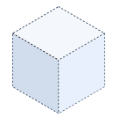



DETAILS ADDED
1
DETAILS ADDED
2
DETAILS ADDED
5
S
S
S
M
M
PO
INTAKE
FEATURE
SCOPED
ARCHITECTURAL
REVIEW
FEATURE
MAPPED
REFINEMENT
STARTED
ACHITECTURAL
PBI & FEATURE
REVIEW
REFINEMENT
COMPLETED
Client
Arch
Agile Dev Team

Slide 4
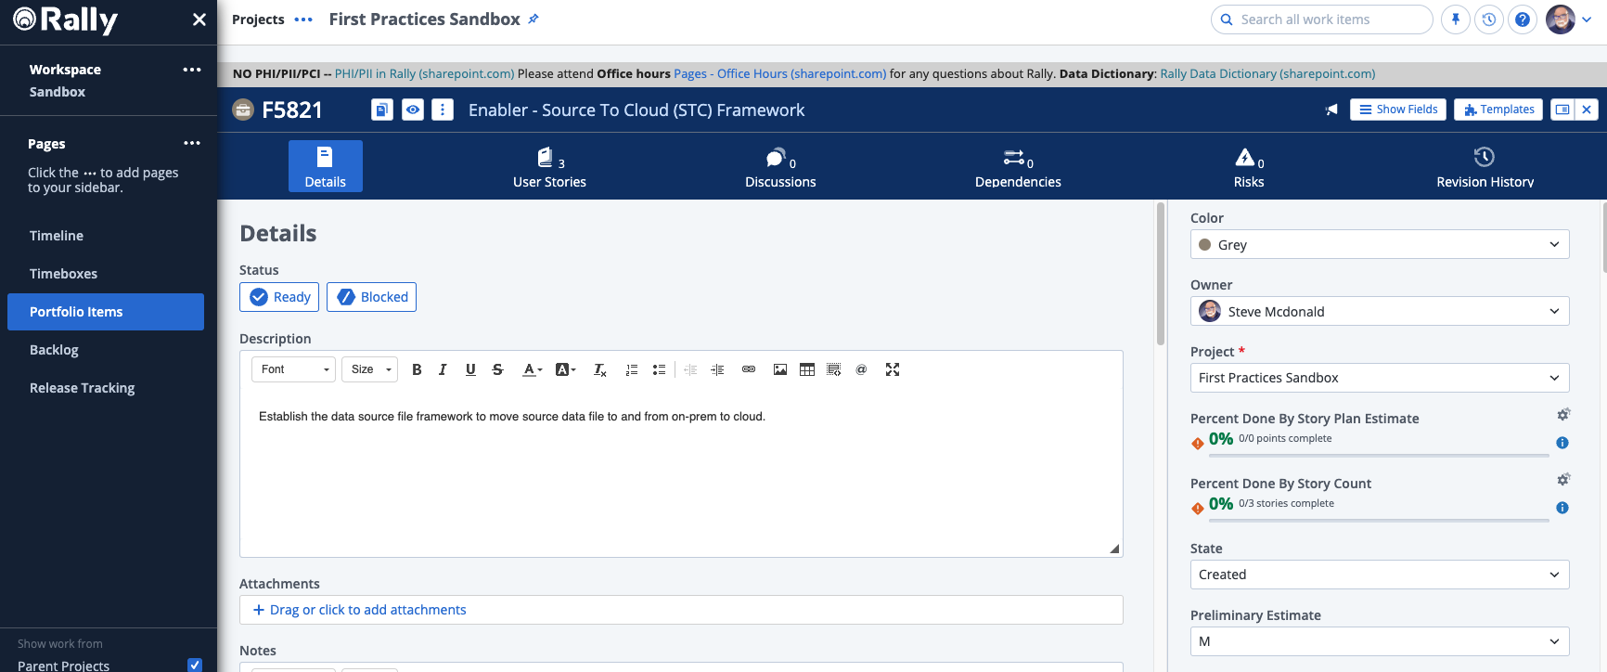
Product Backlog Refinement
WORKFLOW
1 – Feature Scoped
(Pre-Refinement)
PO
Client
Arch
Name:
Preliminary Estimate:
Acceptance Criteria:
Enabler – Source To Cloud Framework
[ ? ] Make a Guess
Permissions established for dev and prod
Move single files less than 2.5GB with process notifications
Move single files more than 2.5GB but less than 10GB with process notifications
Agile Dev Team

Slide 5
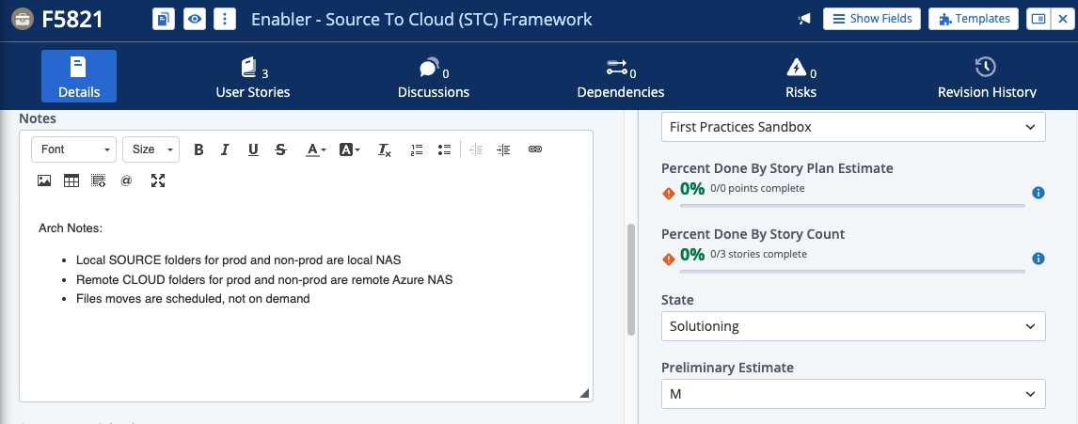
Product Backlog Refinement
WORKFLOW
2 – Architectural Review
(Pre-Refinement)
PO
Client
Arch
Notes:
Preliminary Estimate:
Added as bullets to constrain PBI Solutioning
[ ? ] Updated based on relative sizing by insights from Architecture
Agile Dev Team

Slide 6
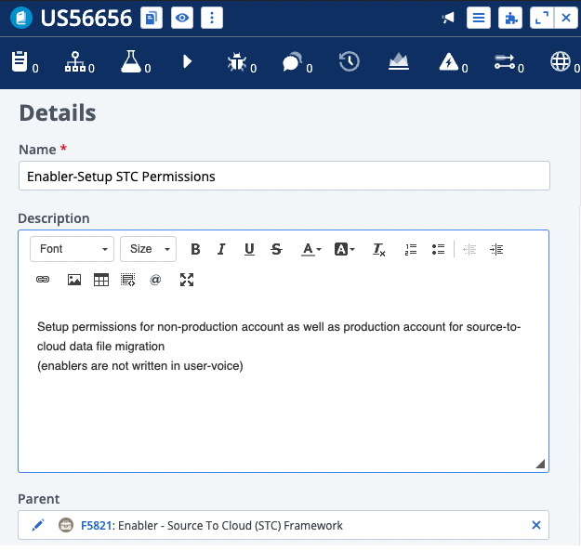
Product Backlog Refinement
WORKFLOW
3 – Feature Mapped
(Pre/Refinement)
Feature: Enabler – STC Framework
PO
PBI: Enabler - Setup Permissions
PBI: Enabler - Setup STC Non-Prod
Client
PBI: Enabler - Setup STC Prod
Description:
Notes:
Acceptance Criteria:
Setup permissions for non-production account as well as production account for source-to-cloud data file migration (Enabled are not written in user-voice)
Any assumptions or facts that do not make solution decisions
Typically, a success scenario…
  “If the file is 2.5GB then it is picked up on a schedule every 3 min and the distribution list is notified of the outcome. If it is more than 2.5gb and less than 10, then pick it up every 15 minutes, and notify on the outcome of the move.”
Arch
Agile Dev Team

Slide 7
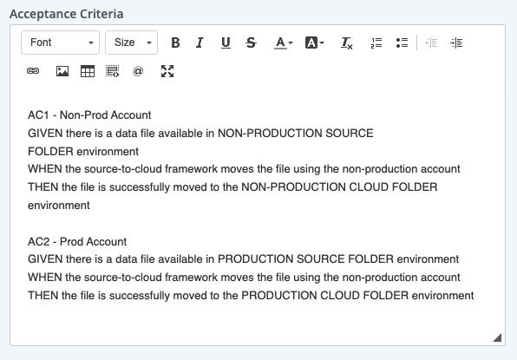
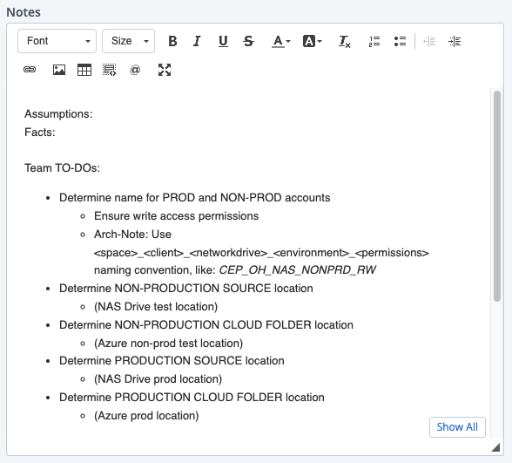

Product Backlog Refinement
WORKFLOW
4 – Refinement Started
Feature: Enabler – STC Framework
PBI: Enabler - Setup Permissions
PO
Client
Arch
TEAM REVIEWS: Description, Notes, & ACs
TEAM refines ACs into Gherkin
From the ACs, team sketches solution activities as potential Team TO-DOs in notes (or story tasks)
Team estimates using relative sizing
Agile Dev Team

Slide 8
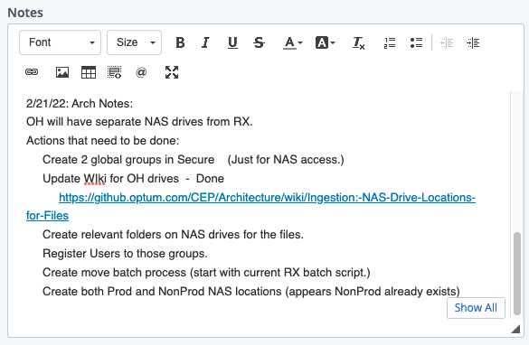
Product Backlog Refinement
WORKFLOW
5 – Arch PBI & FEATURE Review
Feature: Enabler – STC Framework
PBI: Enabler - Setup Permissions
ARCH reviews updated ACs
ARCH reviews the Team TO-DOs ideas in the Notes
Adds Architectural notes in the Notes section to affect the TO-DOs and ACs
Recommend FEATURE estimate changes if needed
PO
Client
Arch
Agile Dev Team

Slide 9
Product Backlog Refinement
WORKFLOW
6 – PBI Refinement Completed
Feature: Enabler – STC Framework
PBI: Enabler - Setup Permissions
Team reviews Arch notes in the NOTES section
Team updates their TO-DO ideas in the NOTES
Team updates PBI Estimate based on feedback
Team recommends Feature estimate change if needed
PO
Client
Arch
Agile Dev Team

